Slide 1

PreDicting Collisions

Slide 2
Predicting collisions
In this project we will try to predict Injury Collision and Property Damage Only Collision, this report are aim to stakeholders interested preventing and reducing injury collisions and Property Damage Only Collision.
All collisions provided by SPD and recorded by Traffic Records. This includes all types of collisions. Collisions will display at the intersection or mid-block of a segment. Timeframe: 2004 to Present. Dataset can be found by Link. MetaData can be found by Link.

Slide 3
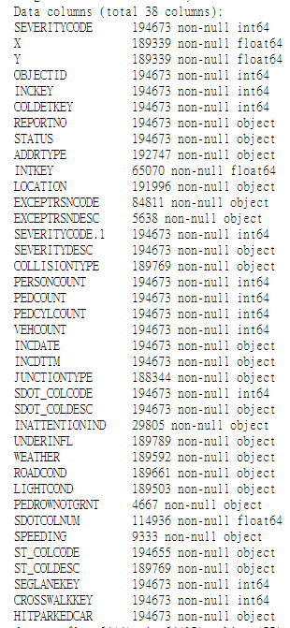
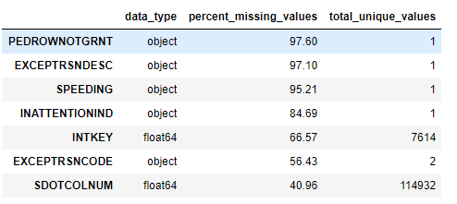
Dataset info
Columns types
Shape : 194673, 38
Top missing value features

Slide 4
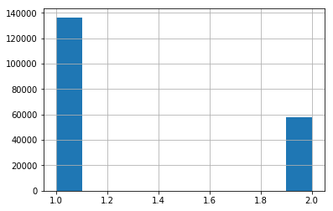
Targets
Severity Code
2: Injury Collision
1: Property Damage Only Collision
We will transform Injury collision to 1 and Property to 0.

Slide 5
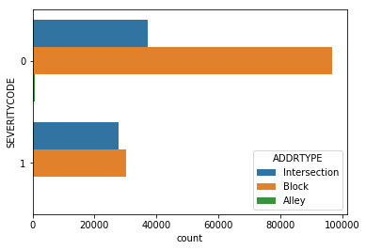
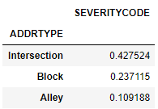
Collision vs Collision address type
With this plot and table we can see that intersection have higher percentage of Injury Collision.

Slide 6
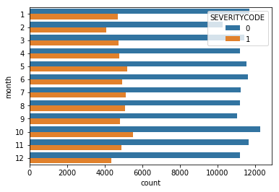
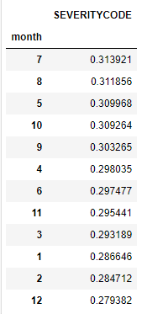
Collision vs Month
Through this chart can see the collision trend through out each month.

Slide 7
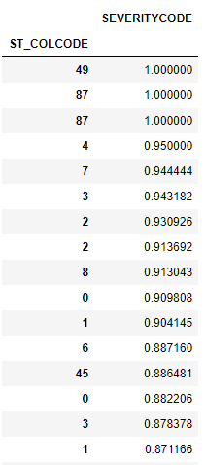
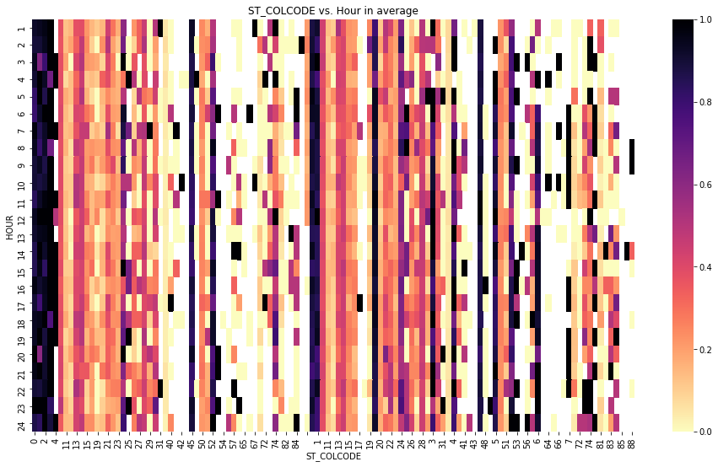
Heatmap State Collision Code Dictionary vs Hour
The darker the point is, the higher percentage of injury collision are.
The slides after are all the same view but with different features.

Slide 8
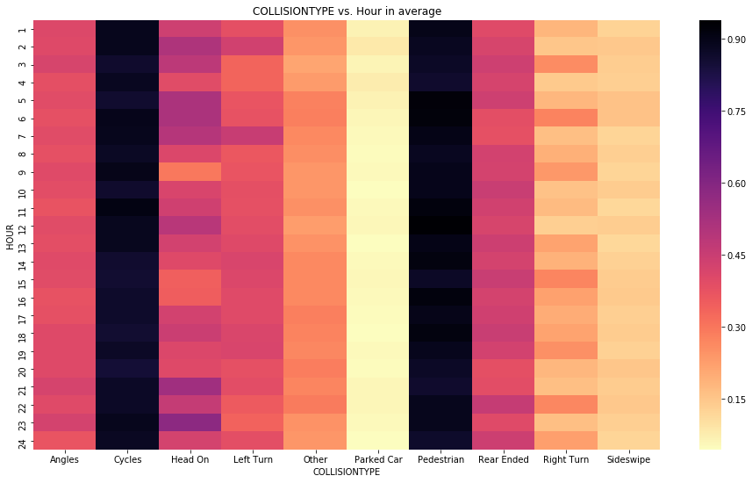
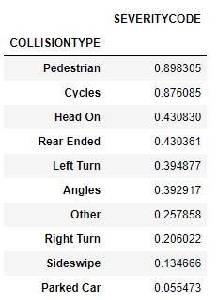
Heatmap State Collision type vs Hour by injury collision percentage

Slide 9
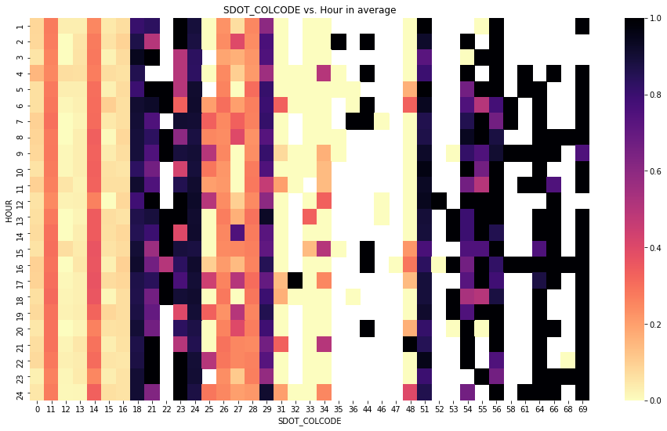
Heatmap Seattle Department of Transportation Code vs Hour by injury collision percentage

Slide 10
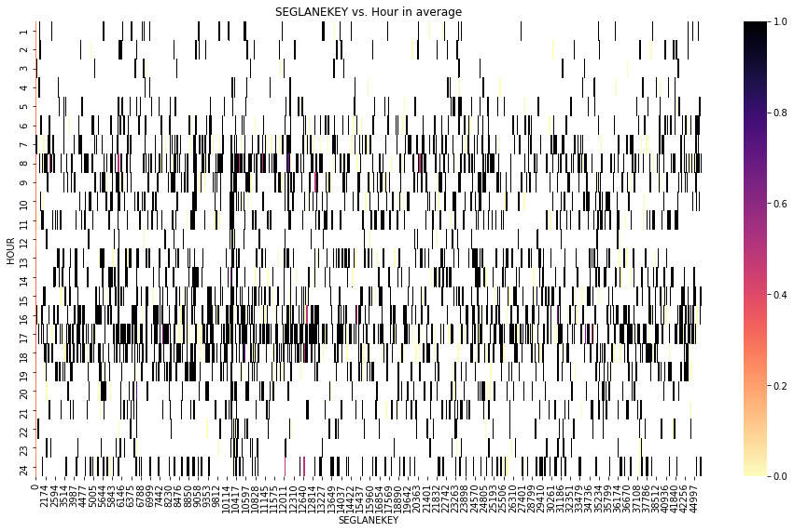
Heatmap Seattle Department of Transportation Code vs Hour by injury collision percentage

Slide 11
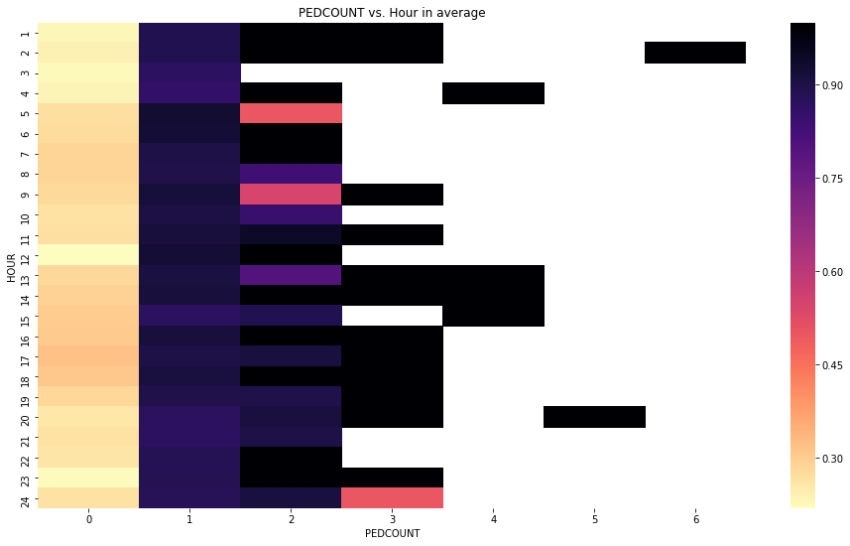
Heatmap number of pedestrians involved vs Hour by injury collision percentage

Slide 12
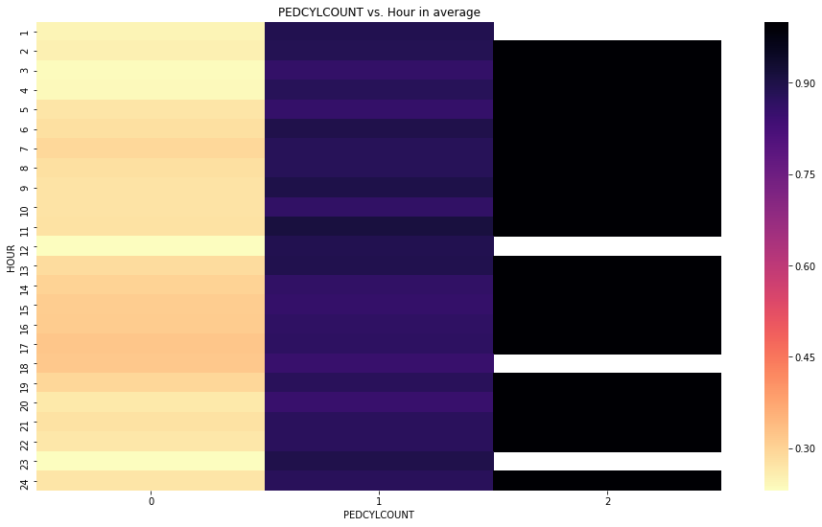
Heatmap vehicles involved in the collision vs Hour by injury collision percentage

Slide 13
Balancing targets
At the top of this paper, we have done a histogram of targets. We know that we have unbalance dataset. So we will have to perform sampling methods, to avoid unbalance issue. In this case we choose over sampling, still there are under sampling, SMOTE to choose with.

Slide 14
Models
Models that we are going to use are LightGBM, Naive Bayes, XGBoost, MLPClassifier. This project was to predict Injury Collision and Property Damage Only Collision in our case this is a classification problem, so models that are selected should be classifier. We have chosen these due to it's faster on modeling comparing KNN and random forest, so that we could know the result and adjust to needs faster.

Slide 15
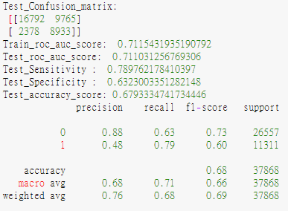
Final Model
For model evaluation will look at AUC, ROC, Sensitivity, Specificity, Precision, Accuracy. With the four model that we have applied Naive Bayes have the highest Accuracy of 0.75 but the lowest in AUC, ROC score, and it's sensitiviy is also very low at 0.2. Although it have an incredible score on specificity, but our goal was trying to avoid injury collisions, naive bayes is out of consideration. LightGBM, XGBoost, and MLPClassifier are all very close. Overall MLPClassifier have slightly out perform than the other two model. In this case we will select MLPClassifier as final selection of model.

Slide 16
Conclusion
The purpose was to predict Injury Collision and Property Damage Only Collision. Our MLPClassifier model provides AUC, ROC score of .71. Detection rate on Injury Collision with 79% and 63% on Property Damage Only Collision. Overall accuracy with 68%, precision .48. On prediction of Injury Collision have 48% accuracy, but when it's detected it has 80% correctness to be Injury Collision and 63% of Property Damage Only Collision accuracy. With this model can increase alertness to people, specially avoiding 80% of Injury Collision.

